Slide 1
Performance Killers
Notes:
Pandera System will access Requisition, Candiate, Resume, Vendor and Master supplier information. On request (Distribute), system will send request to Pandera Service with ReqID as input.
Pandera system will process request, apply pre-filter condition and provide response with all information with Zendex score.
If log is only for Audit purpose, it is better to use MongoDB for Audit log.
For application, we are going to utilize response from Pandera System. [We need sample output/ mock service which will provide sample output.
Pandera system will provide all required columns for us to do sorting and filtering.

Slide 2
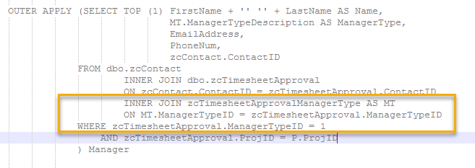



Performance Improvement
For single row, try to find scope to store data into variable and use joins effectively.
Incorrect
Correct

Slide 3
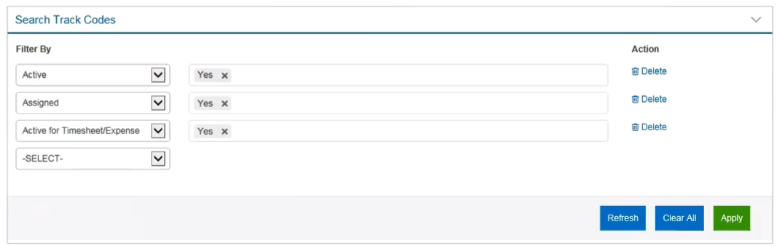
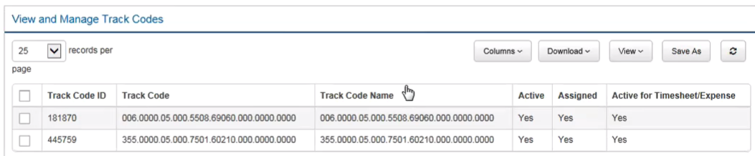
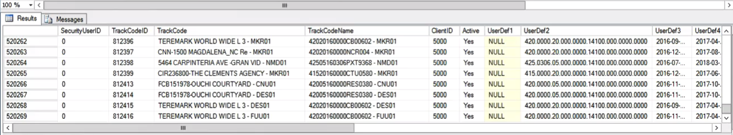
Performance Improvement
Evaluate filter condition at DB level instead of getting all data from SQL and apply filter operation at application level.

Slide 4
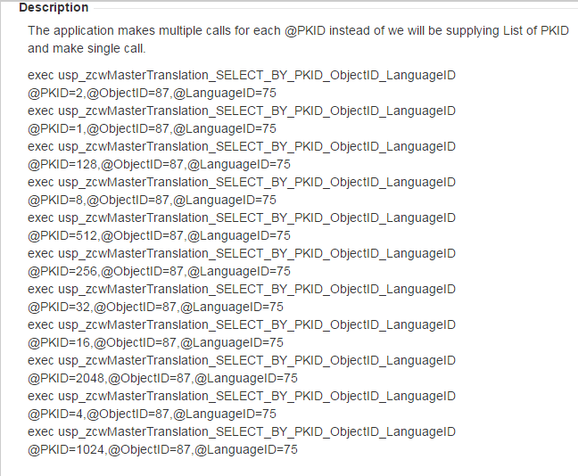
Performance Improvement
Use table parameter for same data pattern and do single DB call

Slide 5
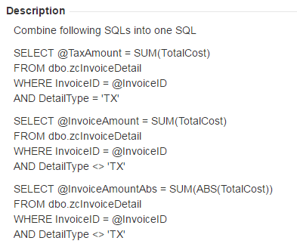
Performance Improvement
Avoid multiple SQL operations and try to combine in SQL.

Slide 6
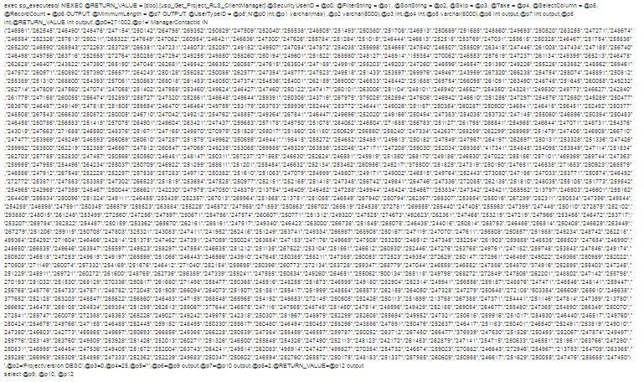
Performance Improvement
Try to avoid data transition from DB to Application and again to Application to DB.

Slide 7
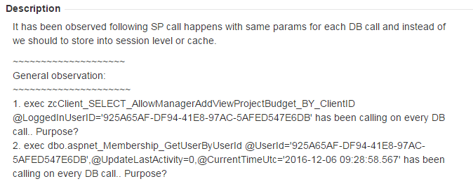
Performance Improvement
Frequently SP call with same parameters on search filter operation.

Slide 8
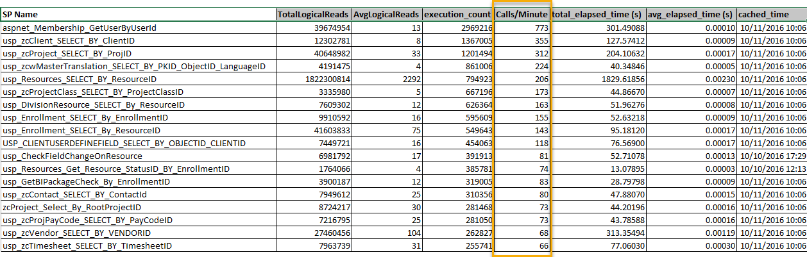
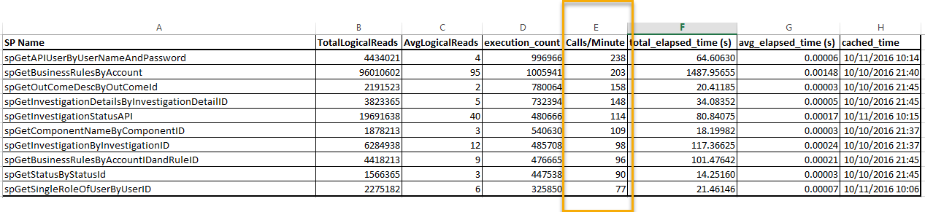
Performance Improvement
General statistics SP call frequency per minute

Slide 9
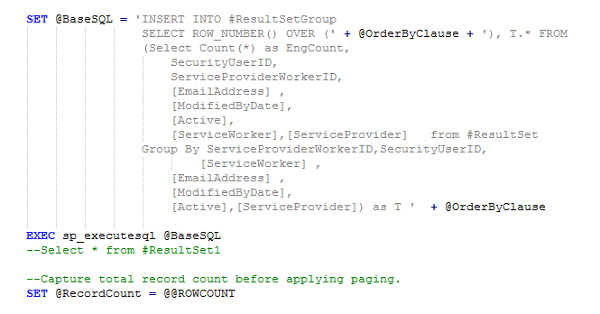
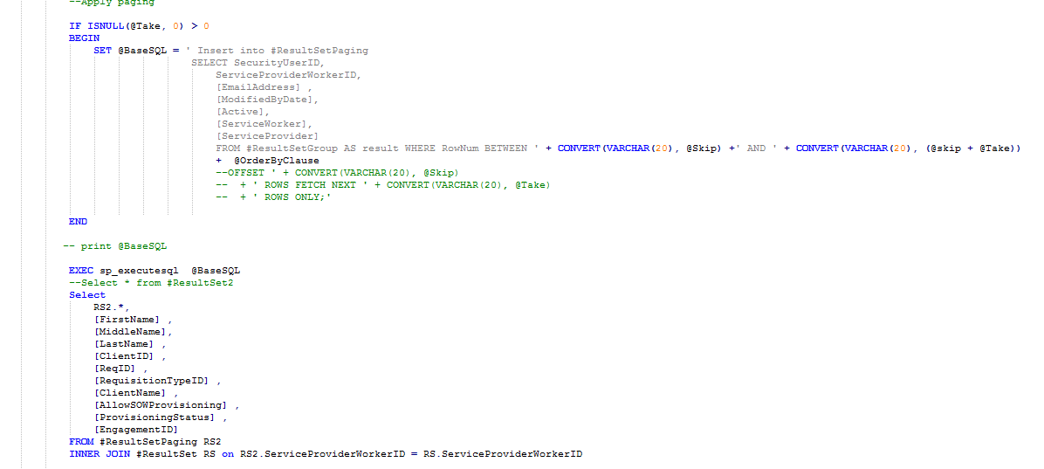
Performance Improvement
Avoid usage of #temp table such as insert all records to get row counts and use row index for pagination.
Still coming with new development/Changes.

Slide 10
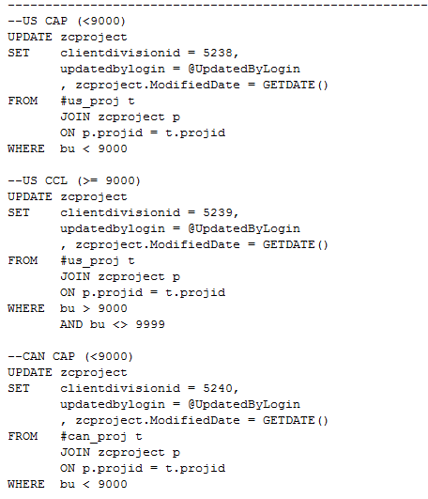
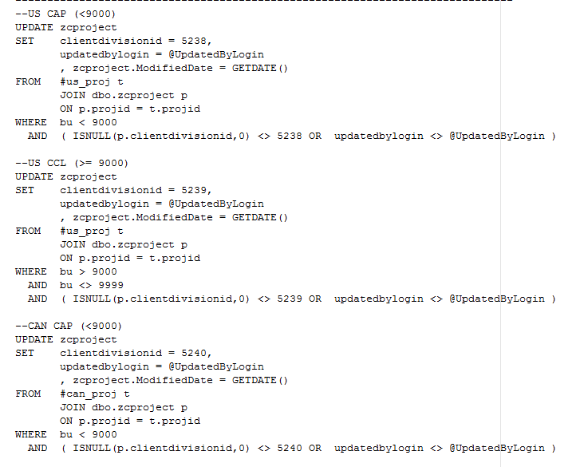
Performance Improvement
Update records when data changed else Skip update operation for same value, it also helps in sync between
Primary and secondary AG process.
Incorrect
Correct

Slide 11
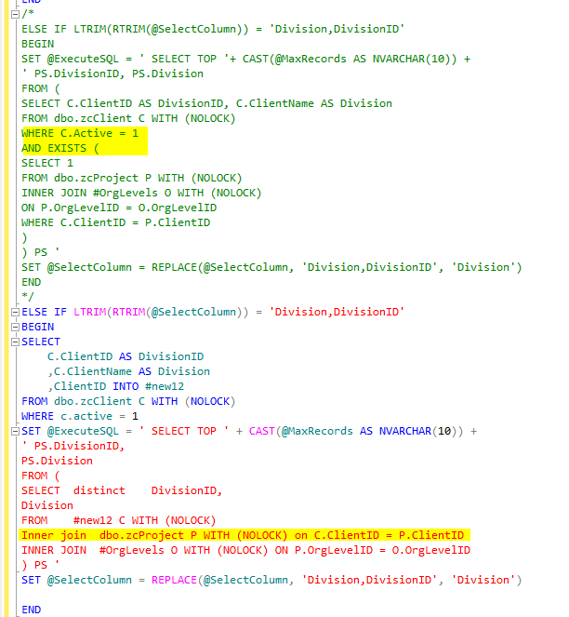
Performance Improvement
Use INNER JOIN instead for WHERE EXISTS wherever possible. But that said, please check for the performance.

Slide 12
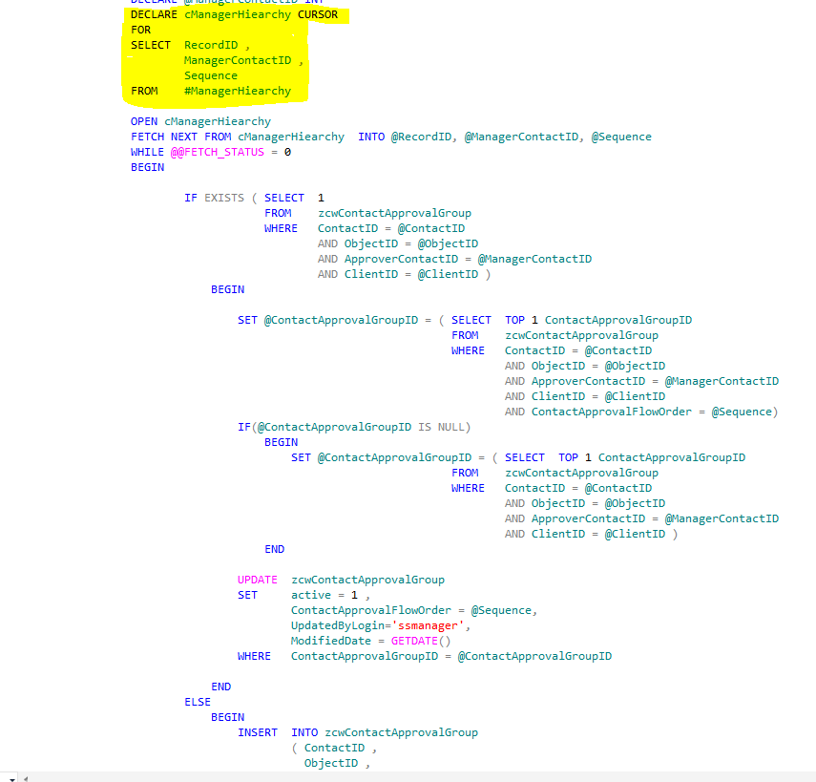
Performance Improvement
Cursors must not be used specially for inserts and updates, remove cursor if you are going to touch any code
containing cursors.

Slide 13
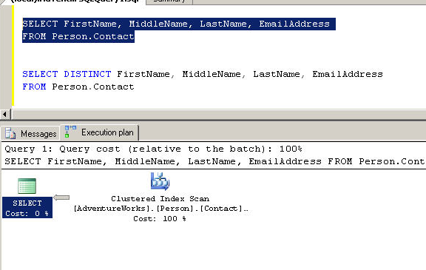
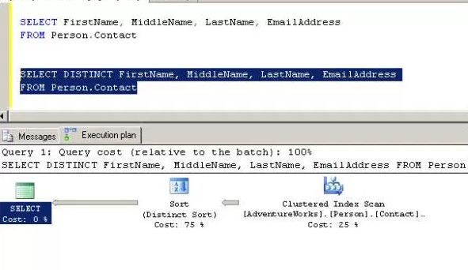
Performance Improvement
The DISTINCT operations are having to go over the whole returned data set to identify unique records.
This can get pretty expensive pretty quirky in terms of database operations.
Comparing both the execution plans reveals that a table scan is still used to retrieve the data from the table. However, a new node has been added to the plan. A sort node and this node is responsible for 75% of the total cost of query.

Slide 14
Procedures Standards
General Practices / Recommendations
Each Procedure should have the following, which is currently missing in many of the Stored Procedures
SET NOCOUNT ON
Stops the message that shows the count of the number of rows affected by a Transact-SQL statement or stored procedure from being returned as part of the result set. For big procedures this surely affect performance.
SET ANSI NULLS ON (SET ANSI NULLS OFF would be deprecated in future versions of SQL Server).
SET XACT_ABORT ON (IF Error handling is not done with Begin Try / End Try)
OFF : Indicates that only the Transact-SQL statement that raised the error is rolled back and the transaction continues.
Other side effect is that a cancel/timeout error can leave an open transaction
ON : Instructs SQL Server to rollback the entire transaction and abort the batch when a run-time error occurs.
Avoid using Large Text Data Type
Avoid using text, ntext datatypes for storing larger textual data. “Text” datatype has some inherent problems associated with it. You cannot directly write, update text data using INSERT, UPDATE statements, you have to use special statements like READTEXT, WRITETEXT AND UPDATETEXT. Instead use NVARCHAR(MAX), VARCHAR(MAX)

Slide 15
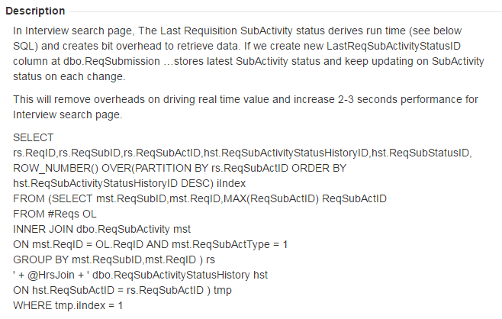
Procedures Standards
General Practices / Recommendations
Addition of new column instead of joining history table to get last status frequently.

Slide 16
Procedures Standards
General Practices / Recommendations
Separate SP for Filter and Grid for search pages.
Insert is faster than update for log activity so if status is not real time then recommended to have batch process.
Updates created double transaction log than Insert and Delete
Update hold page lock that Insert Operation.
Best Example: Email Transaction log activity and Archiving process.
Unused Parameters.
Many a times it is found that Parameter is passed from app , but never used in stored procedure.
Usage of union
This is tremendously used. We need to try to get distinct records without using Distinct / Union clauses. As this clauses are very expensive.
Procedure / View Updates.
Whenever procedure / view is updated, by adding / removing joins, please revisit for performance stats for all the filter parameters sets.

Slide 17
Procedures Standards
Error Handling
Proper Error handling should be done in procedures to ensure integrity. Below is the statistics for current database state
Begin Try
< Code To Execute >
End Try
Begin Catch
<Handling Error Message>
End Catch

Slide 18
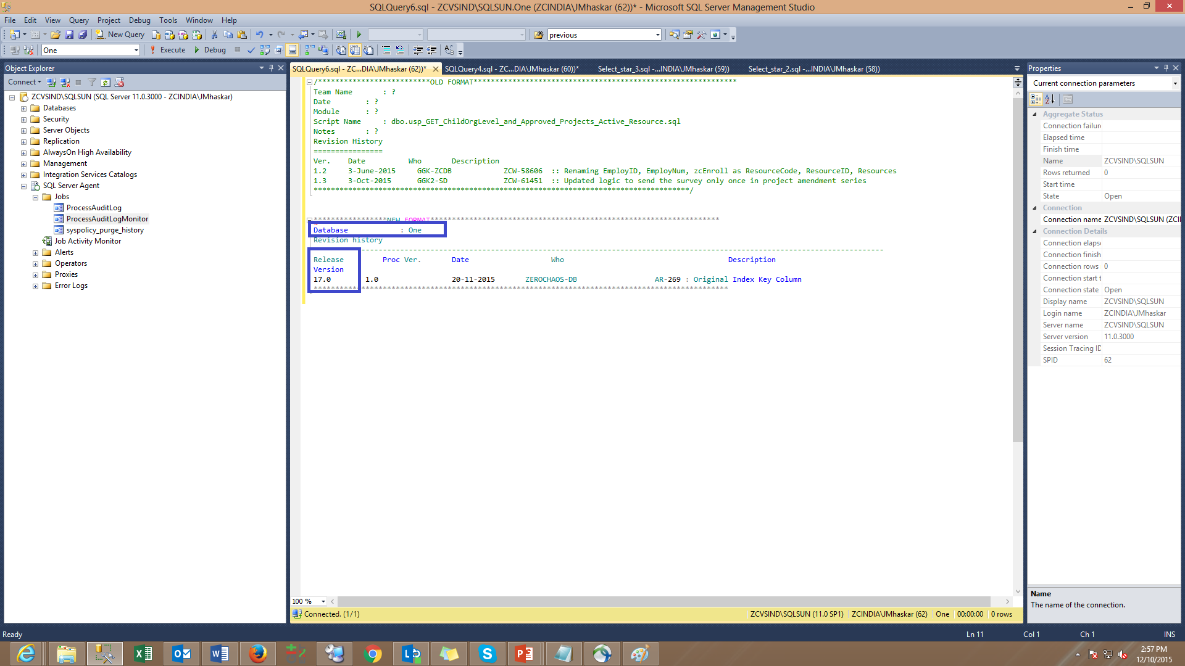
Procedures Standards
General Practices / Recommendations
There are many procedures in the system which either don’t have revision history at all or they are not updated. The following revision history format helps us while debugging the procedure.

Slide 19
Procedures Standards
General Practices / Recommendations
EXISTS vs INNER JOIN : If no of records are less from outer table then we can go for EXISTS operator. If this count is huge then it is better to go for JOINs, because EXISTS does LOOP JOIN always. It is costly. Same criteria is applicable for NOT EXISTS vs LEFT JOIN.
While using exists, use 'SELECT 1' instead of 'SELECT *' If number of rows in subset are more than a million, use 'SELECT TOP 1 1'
Avoid using multiple similar queries. For example, if we want to calculate individual count for Open , submitted , Approved then go for a single query(using CASE WHEN logic). Instead of three separate sub/inline queries.
Avoid using functions on columns in WHERE and JOIN conditions. These will suppress participating indexes in the query execution
Avoid using separate OR conditions if we are checking condition for same column
Example
--------------------------------
WHERE ReqStatusID = 1
OR ReqStatusID = 2
OR ReqStatusID = 5
OR ReqStatusID = 6
--------------------------------
WHERE ReqStatusID IN (1,2,5,6)
Avoid using sub queries and inline queries. We can achieve the same using LEFT JOIN.

Slide 20
Procedures Standards
General Practices / Recommendations
Use Alias when using SubQuery in Where Condition
While writing migration scripts :
Need to make sure the transaction scope is very less. For eg: we can take backup of all tables before transaction is being opened.
We are taking a single record backup into one temp table and driving the functionality. Means, if records exists in this table then don’t proceed further. Suppose if there are multiple tables inside the script and any of the table got failed due to some error then it would not be corrected even in next run also. Because our script would not support this scenario.
Script should be rerunnable doesn’t mean that we can re-execute the script. It means if there are any errors in the first run after re-executing the script it should be covered that.
All scripts should have proper naming convention and script order while checking into source control
All scripts should have revision history with the aligned jira case number and the corresponding change
Sprocs should be preceded with schema name
Views should be preceded with schema. We can specify numbering if it is really necessary.
Scripts which are in Pre-Schema , Schema , scripts folders should have proper numbering.
Pre-Schema : If there are any scripts to run prior to schema changes then those will parked here. For eg: Taking backup of a table
Schema : All schema changes should be here.
Scripts : Only data modification scripts should be here. If we are parking any schema change script here there should be a solid reason for it.

Slide 21
Procedures Standards
General Practices / Recommendations
In case of altering any columns, the script should be dynamic. Means,
SQL server will not allow alter a column if there are any dependent objects on it. For eg , indexes , constraints and stats., etc..
We are hard coding the names in the scripts in this case.
If there was a constraint created without a name then system will provide a name and it is not readable. We have two data centers and the same constraint was created with two different names. So we have to write two scripts for the same change. Instead of the we can get the constraint name from meta data tables and use it in our script.
Sometimes we are hard coding statistics names, it is not a best practise as stated above.
Every new table should have
CreatedByID, ModifiedByID with NOT NULL constraint. We can use default value 86235 based on your possibility
ModifiedDate, CreatedDate with NOT NULL constraint. We can use default value getdate() based on your possibility. These are mandatory for tables. Would these require for a small master table also ? Yes, required. These two are most important for ETL team. They pull data based on ModifiedDate column. If it is not present then they have to write a separate statement(logic) to pull the data. It is over burden for the ETL process

